Slide 1
Suicidal Thoughts, Behaviors, and Event-Related Potentials: A Meta-Analysis
Austin Gallyer

Slide 2
Topic Definition
Are event-related potentials able to distinguish those with a suicide attempt from those who do not, and those with suicidal ideation from those who do not think about suicide?

Slide 3

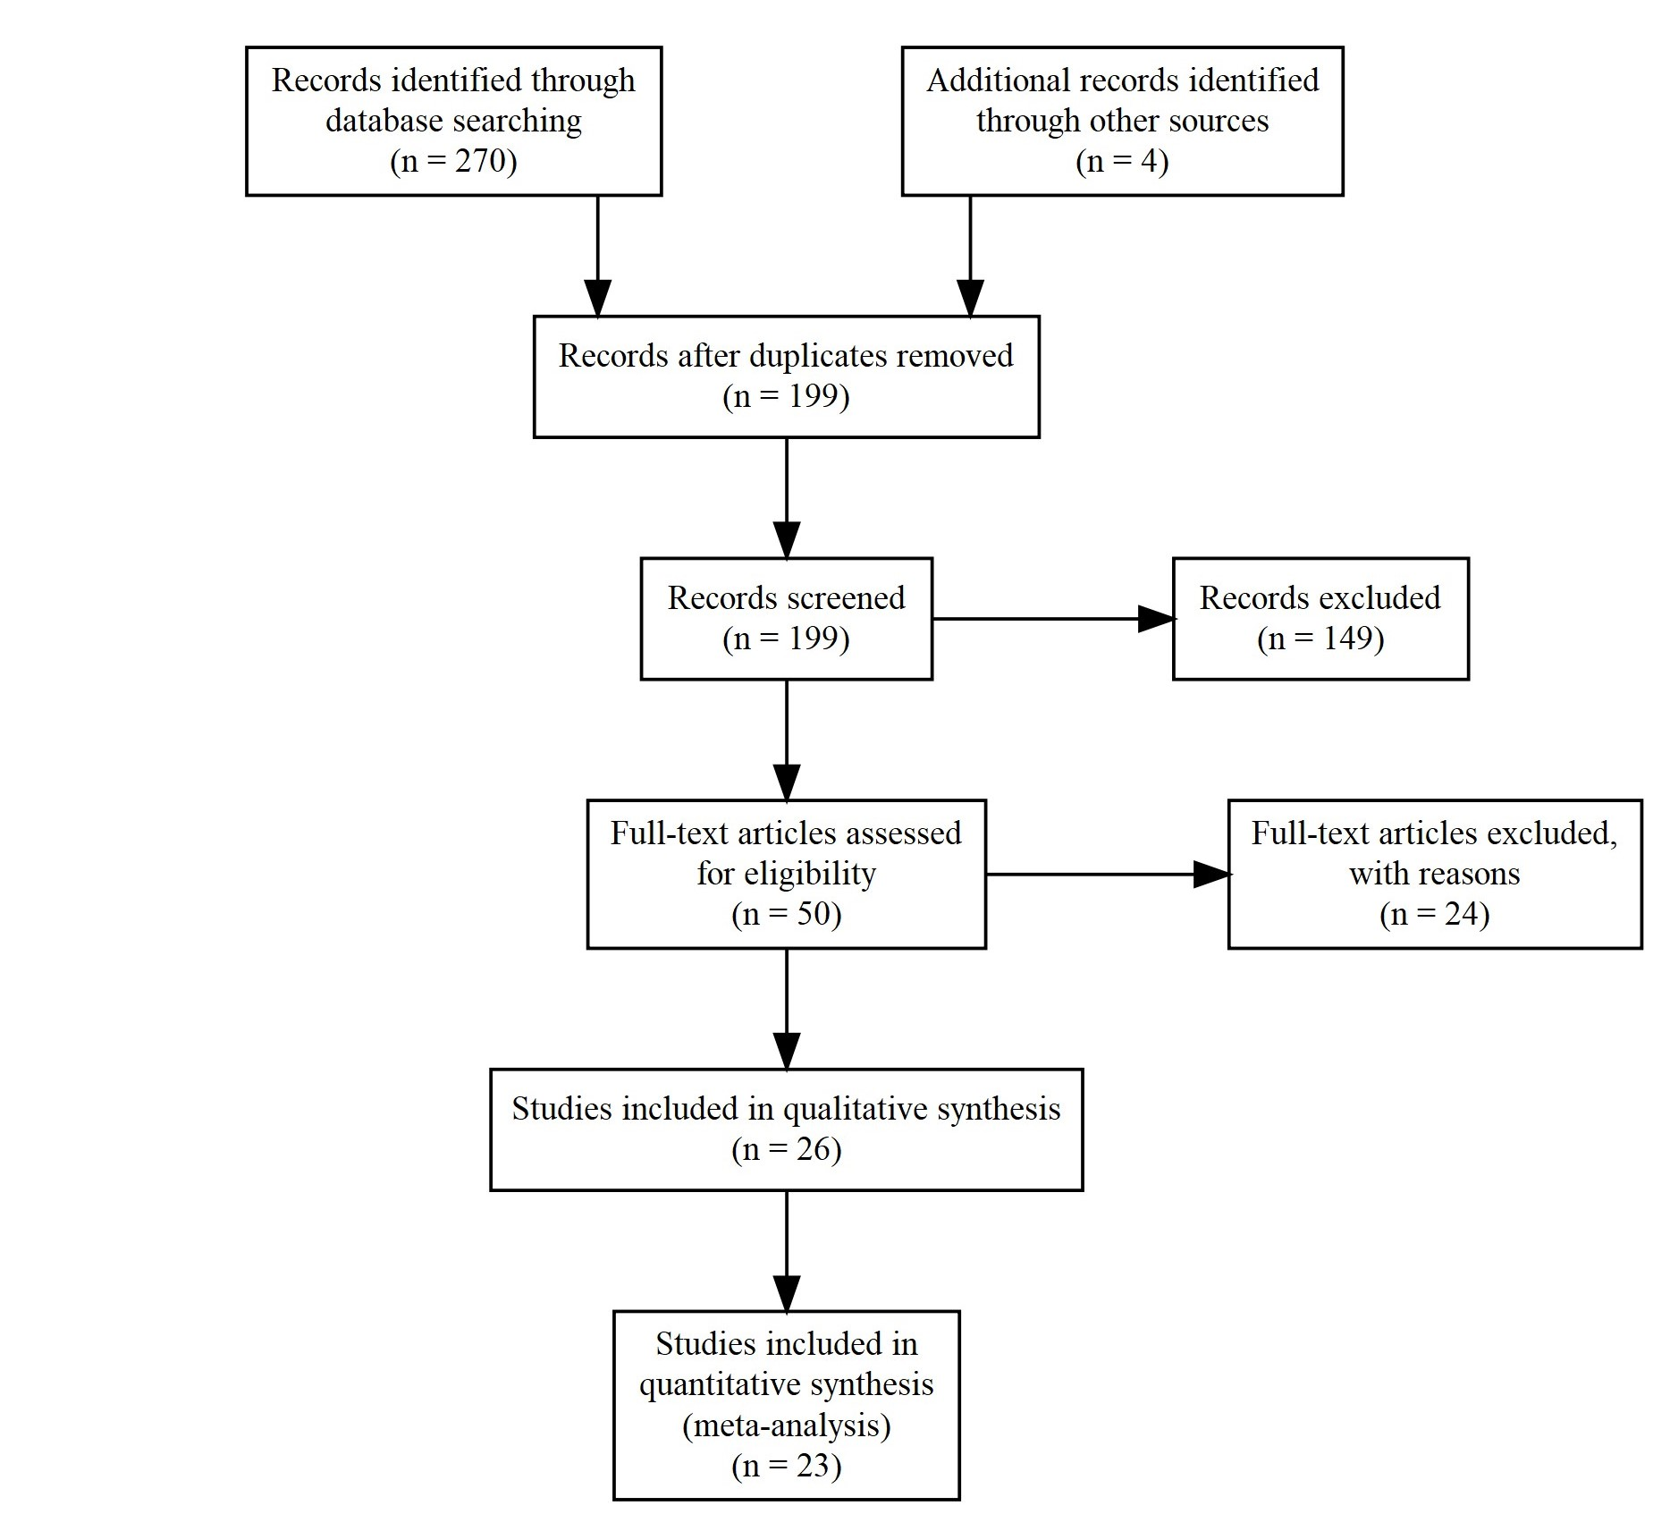

Slide 4
Analysis
Random effects model (REML) with three levels
Absolute value Hedges’ g
Robust cluster estimator for many dependent effects (Hedges, Tipton, & Johnson, 2010)
Three outcomes (ideation, attempt, and “risk”)

Slide 5

Suicidal ideation vs. No Ideation

Slide 6
Suicidal ideation vs. No Ideation

Slide 7
Ideation Moderators
 | Estimate | Pval | ci.Lb | ci.ub
Intercept | 0.33 | 0.002 | 0.27 | 0.39
LPP | -.13 | 0.431 | -0.72 | 0.46
RewP | -0.12 | 0.571 | -0.85 | 0.62
P3 | 0.25 | 0.087 | -0.09 | 0.59
Other | 0.12 | 0.303 | -0.25 | 0.48
F(4, 2) = 2256.42, p < .001

Slide 8
Other ideation moderators
Scoring (raw vs. difference) F(1, 5) = 0.54, p = 0.498
Age F(1, 5) = 2.68, p = 0.163
Sample size F(1, 5) = 465.93, p < .001
Notes:
Diminishes from .4 to .1

Slide 9
Suicide Attempt vs. No Attempt

Slide 10
Suicide Attempt vs. No Attempt

Slide 11
Ideation Moderators
 | Estimate | Pval | ci.Lb | ci.ub
Intercept | 0.56 | <0.001 | 0.33 | 0.79
LPP | -0.27 | 0.029 | -0.50 | -0.04
RewP | -0.32 | 0.014 | -0.55 | -0.09
P3 | -0.20 | 0.252 | -0.57 | 0.18
Other | -0.13 | 0.391 | -0.45 | 0.20
F(4, 7) = 31.90, p < .001

Slide 12
Other attempt moderators
Scoring (raw vs. difference) F(1, 9) = 0.70, p = 0.424
Age F(1, 6) = 26.11, p = 0.002
Sample size F(1, 10) = 3.22, p = .103
Notes:
As age increases, effect size decreases

Slide 13
Suicide Risk

Slide 14
Suicide Risk

Slide 15
Ideation Moderators
 | Estimate | Pval | ci.Lb | ci.ub
Intercept | 0.32 | 0.235 | -0.51 | 1.15
LPP | 0.03 | 0.874 | -0.79 | 0.86
P3 | 0.27 | 0.293 | -0.56 | 1.10

Slide 16
Other risk moderators
Scoring (raw vs. difference) F(1, 3) = 0.85, p = 0.426
Age F(1, 3) = 8.82, p = 0.059
Sample size F(1, 3) = 1.17, p = 0.359

